Slide 1
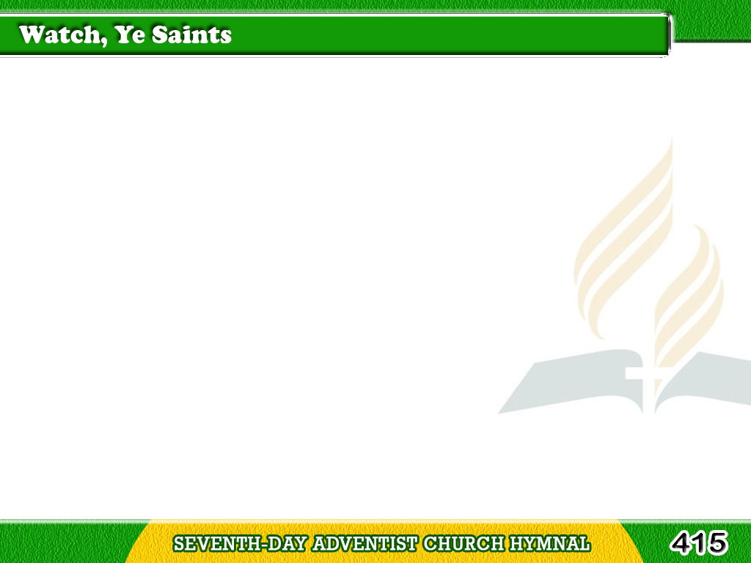
1/5
Watch, ye saints,
with eyelids waking;
Lo! the powers
of heaven are shaking;
Tagalog
Version

Slide 2
1/5
Keep your lamps
all trimmed and burning,
Ready for your Lord’s
returning.
Tagalog
Version

Slide 3
1/5
Chorus
Lo! He comes, lo! Jesus comes;
Lo! He comes,
He comes all glorious!
Jesus comes to reign victorious,
Lo! He comes, yes, Jesus comes.
Tagalog
Version

Slide 4
2/5
Lo! the promise of your Savoir,
Pardoned sin
and purchased favor,
Tagalog
Version

Slide 5
2/5
Blood-washed robes
and crowns of glory;
Haste to tell redemption’s story.
Tagalog
Version

Slide 6
2/5
Chorus
Lo! He comes, lo! Jesus comes;
Lo! He comes,
He comes all glorious!
Jesus comes to reign victorious,
Lo! He comes, yes, Jesus comes.
Tagalog
Version

Slide 7
3/5
Kingdom at their base
are crumbling,
Hark! His chariot wheels
are rumbling;
Tagalog
Version

Slide 8
3/5
Tell, O tell of grace
abounding,
While the seventh trump
is sounding.
Tagalog
Version

Slide 9
3/5
Chorus
Lo! He comes, lo! Jesus comes;
Lo! He comes,
He comes all glorious!
Jesus comes to reign victorious,
Lo! He comes, yes, Jesus comes.
Tagalog
Version

Slide 10
4/5
Nations wane,
though proud and stately;
Christ His kingdom
hasteneth greatly;
Tagalog
Version

Slide 11
4/5
Earth her latest pangs
is summing;
Shout, ye saints,
your Lord is coming.
Tagalog
Version

Slide 12
4/5
Chorus
Lo! He comes, lo! Jesus comes;
Lo! He comes,
He comes all glorious!
Jesus comes to reign victorious,
Lo! He comes, yes, Jesus comes.
Tagalog
Version

Slide 13
5/5
Sinners, come,
while Christ is pleading;
Now for you He’s interceding;
Tagalog
Version

Slide 14
5/5
Haste, ere grace
and time diminished
Shall proclaim
the mystery finished.
Tagalog
Version

Slide 15
5/5
Chorus
Lo! He comes, lo! Jesus comes;
Lo! He comes,
He comes all glorious!
Jesus comes to reign victorious,
Lo! He comes, yes, Jesus comes.
Tagalog
Version

